Slide 1
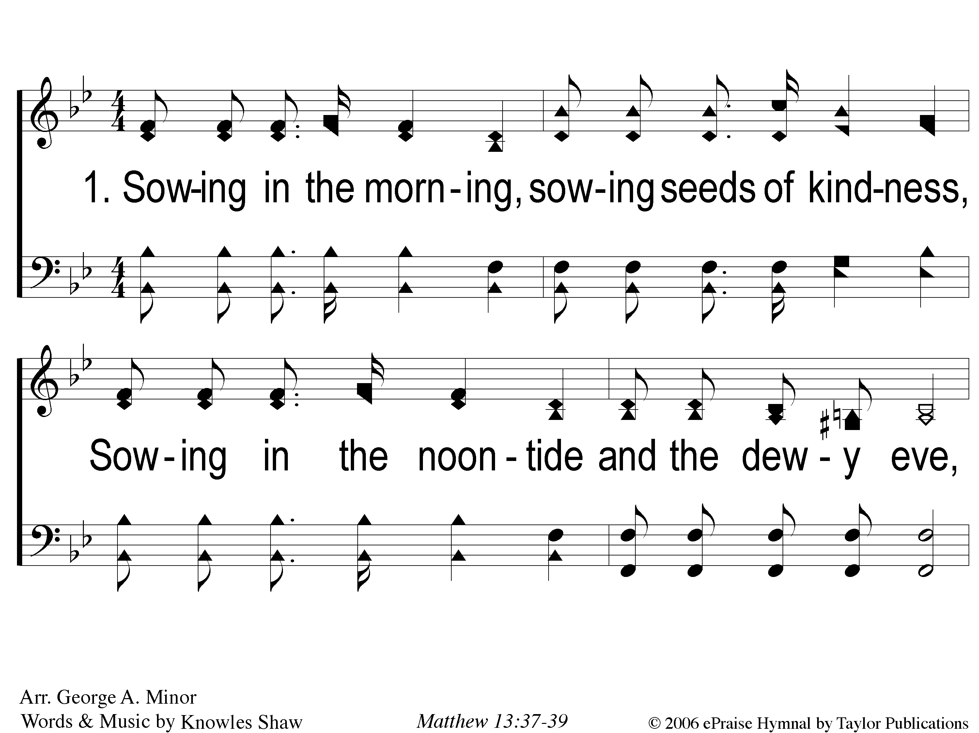
1-1 Bringing In The Sheaves
Bringing In The Sheaves
56

Slide 2
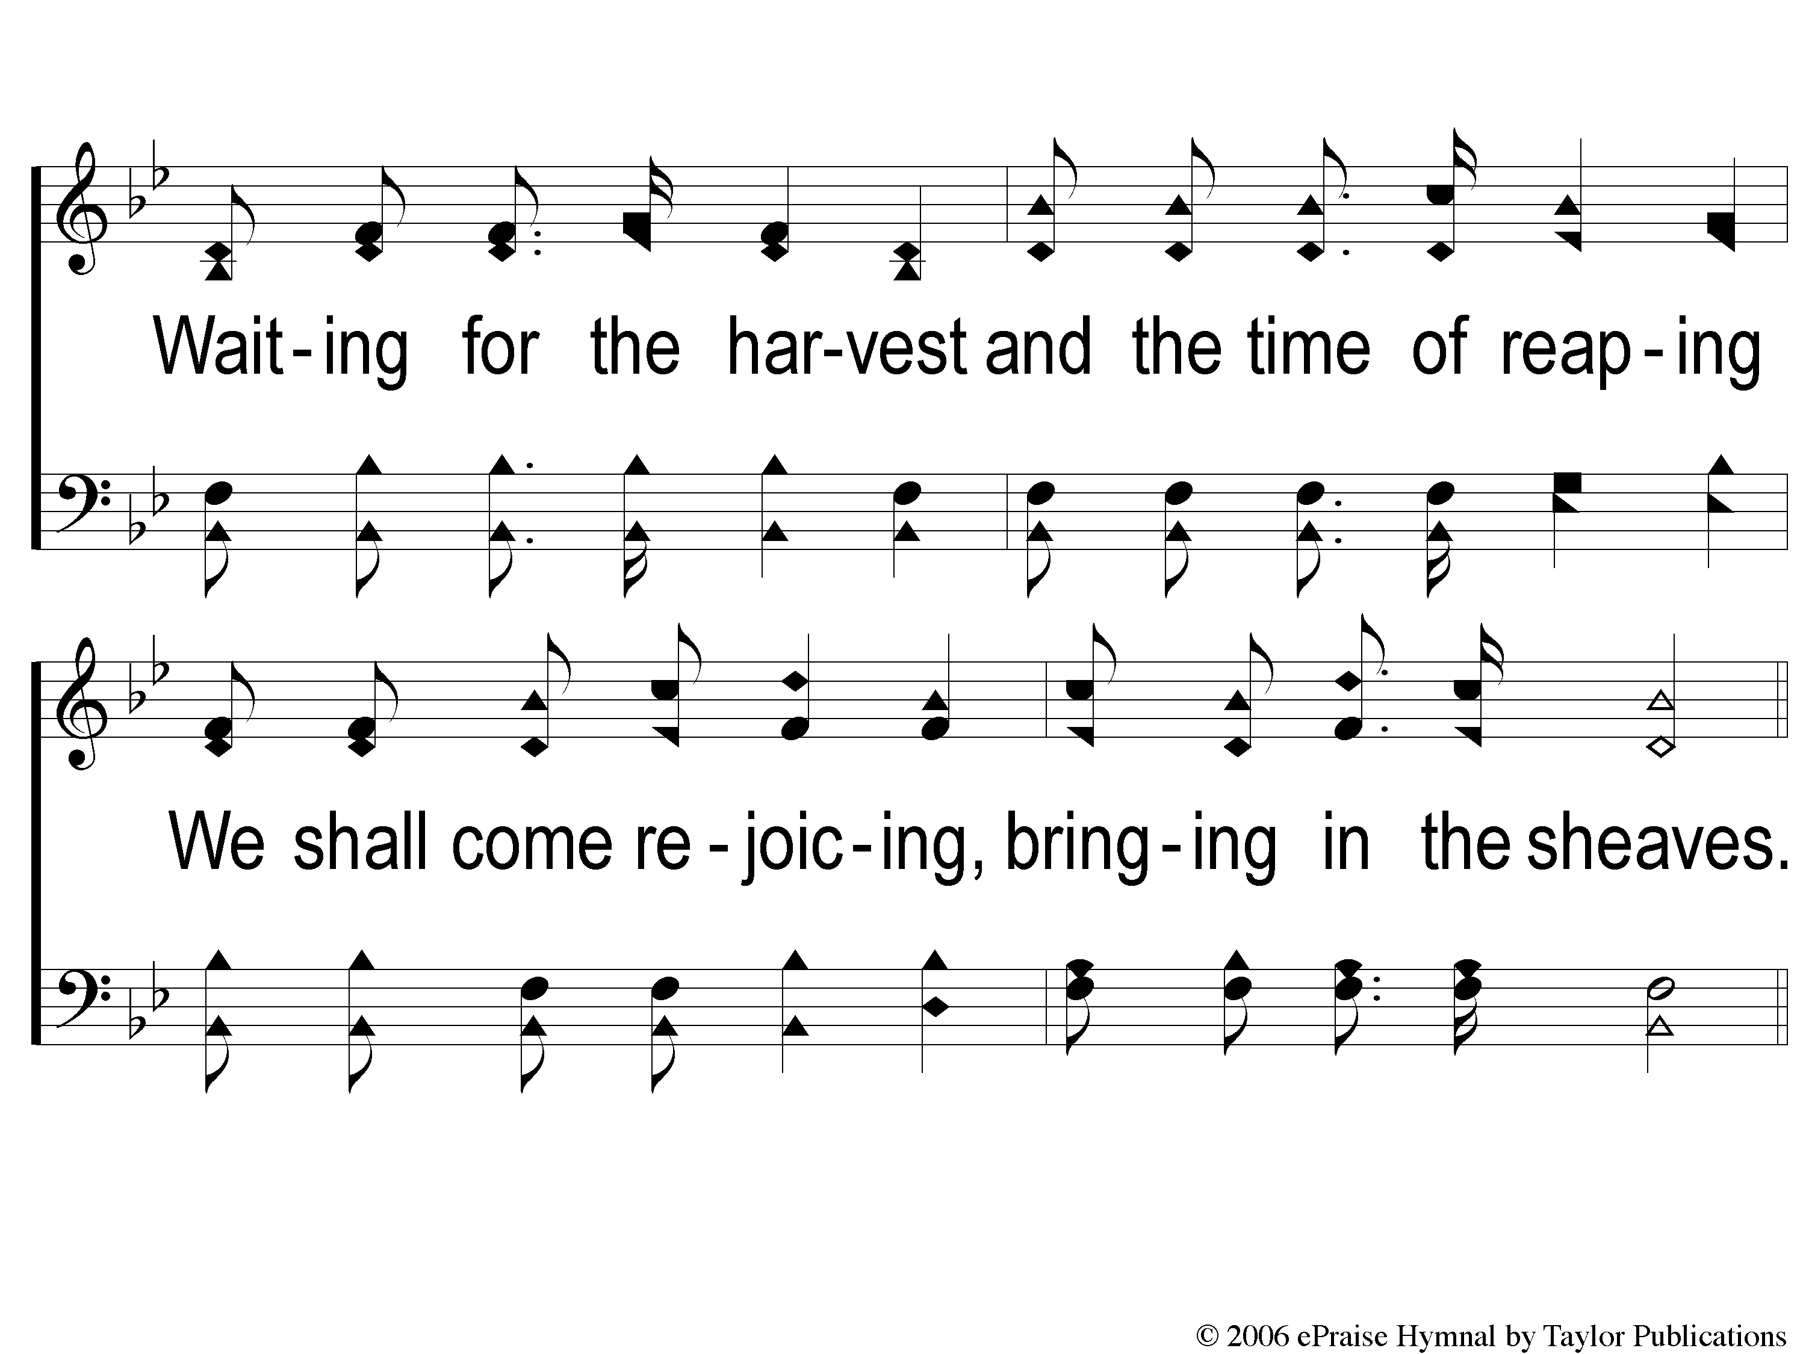
1-2 Bringing In The Sheaves
Bringing In The Sheaves
56

Slide 3
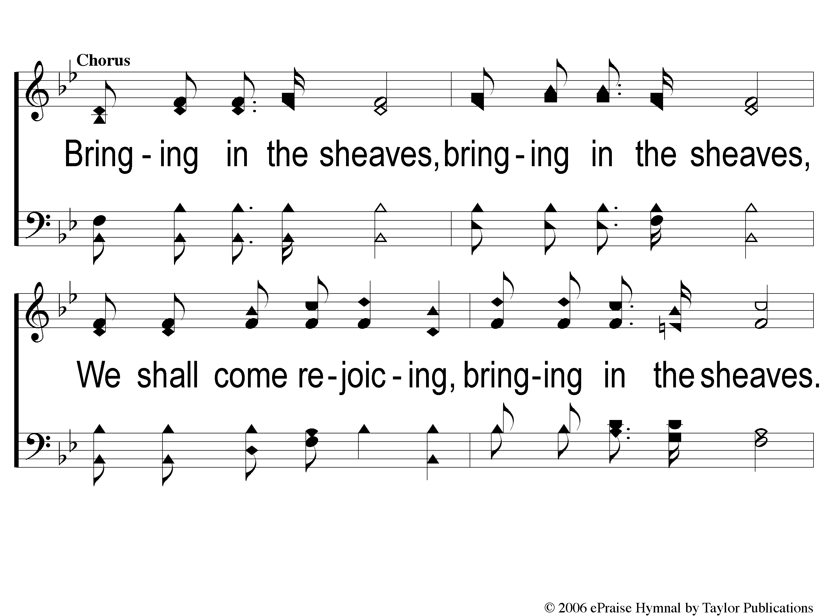
C-1 Bringing In The Sheaves
Bringing In The Sheaves
56

Slide 4
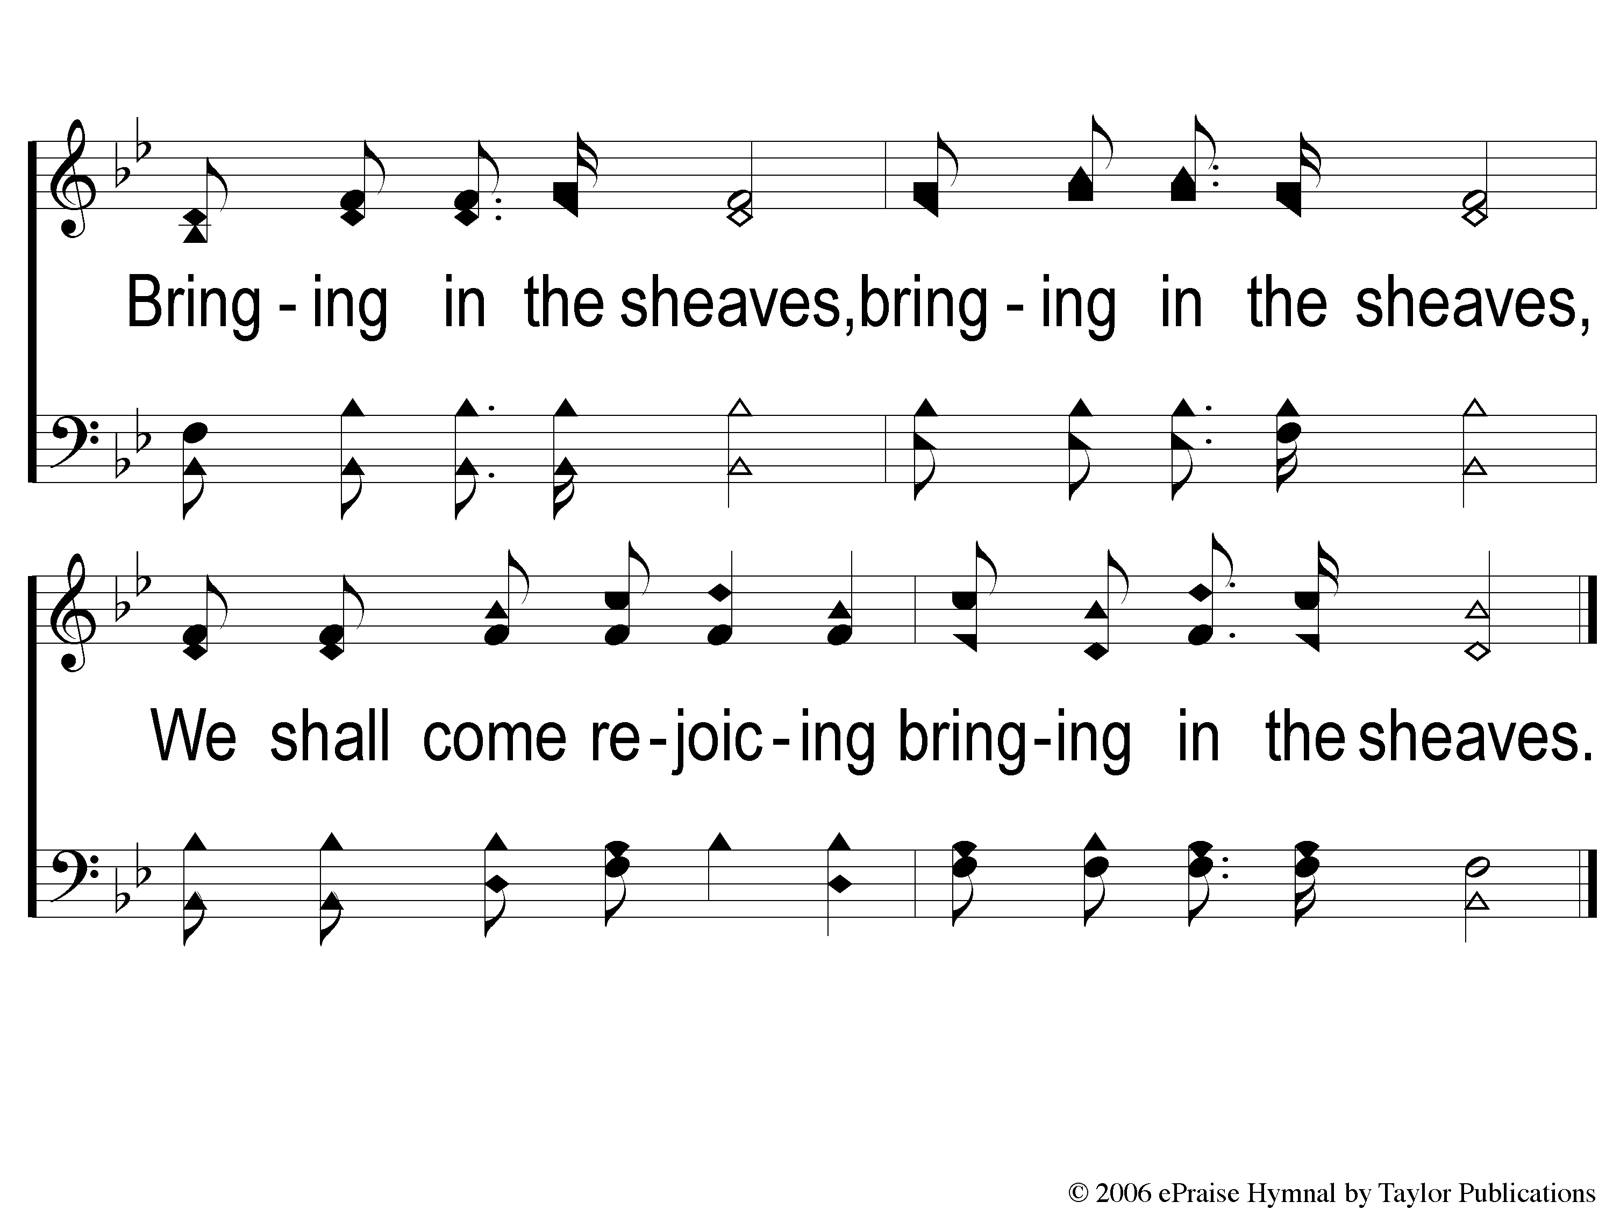
C-2 Bringing In The Sheaves
Bringing In The Sheaves
56

Slide 5
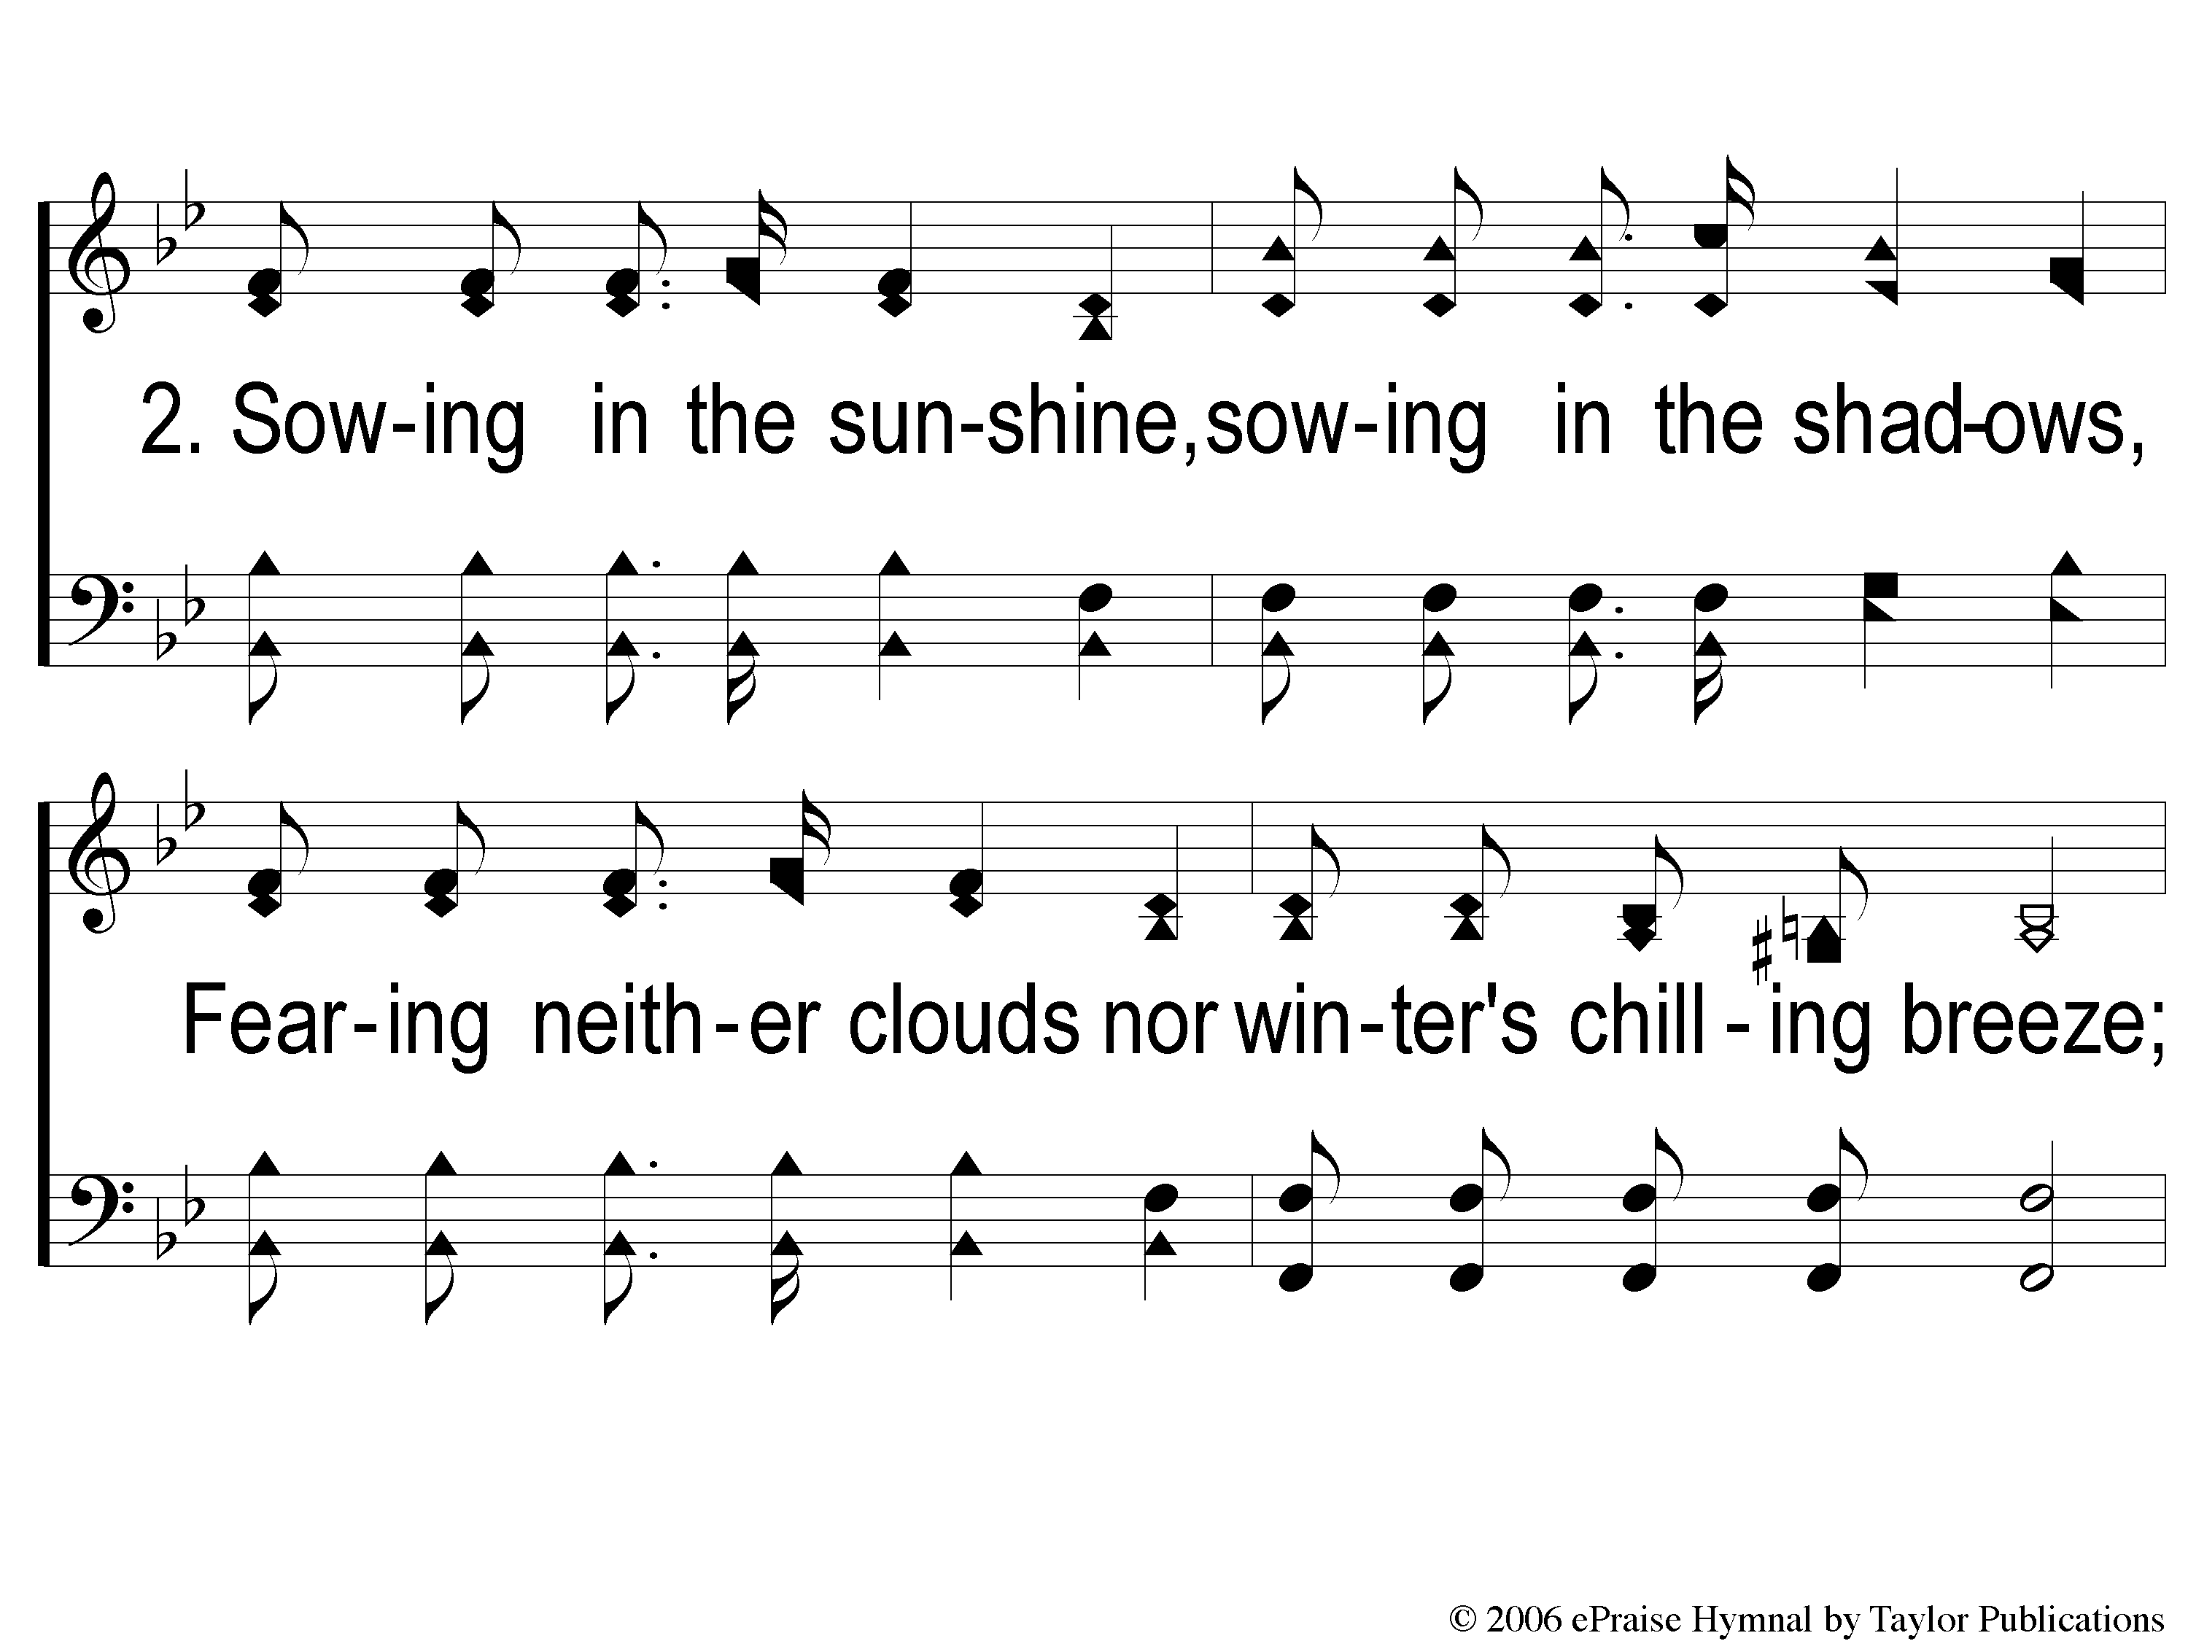
2-1 Bringing In The Sheaves
Bringing In The Sheaves
56

Slide 6
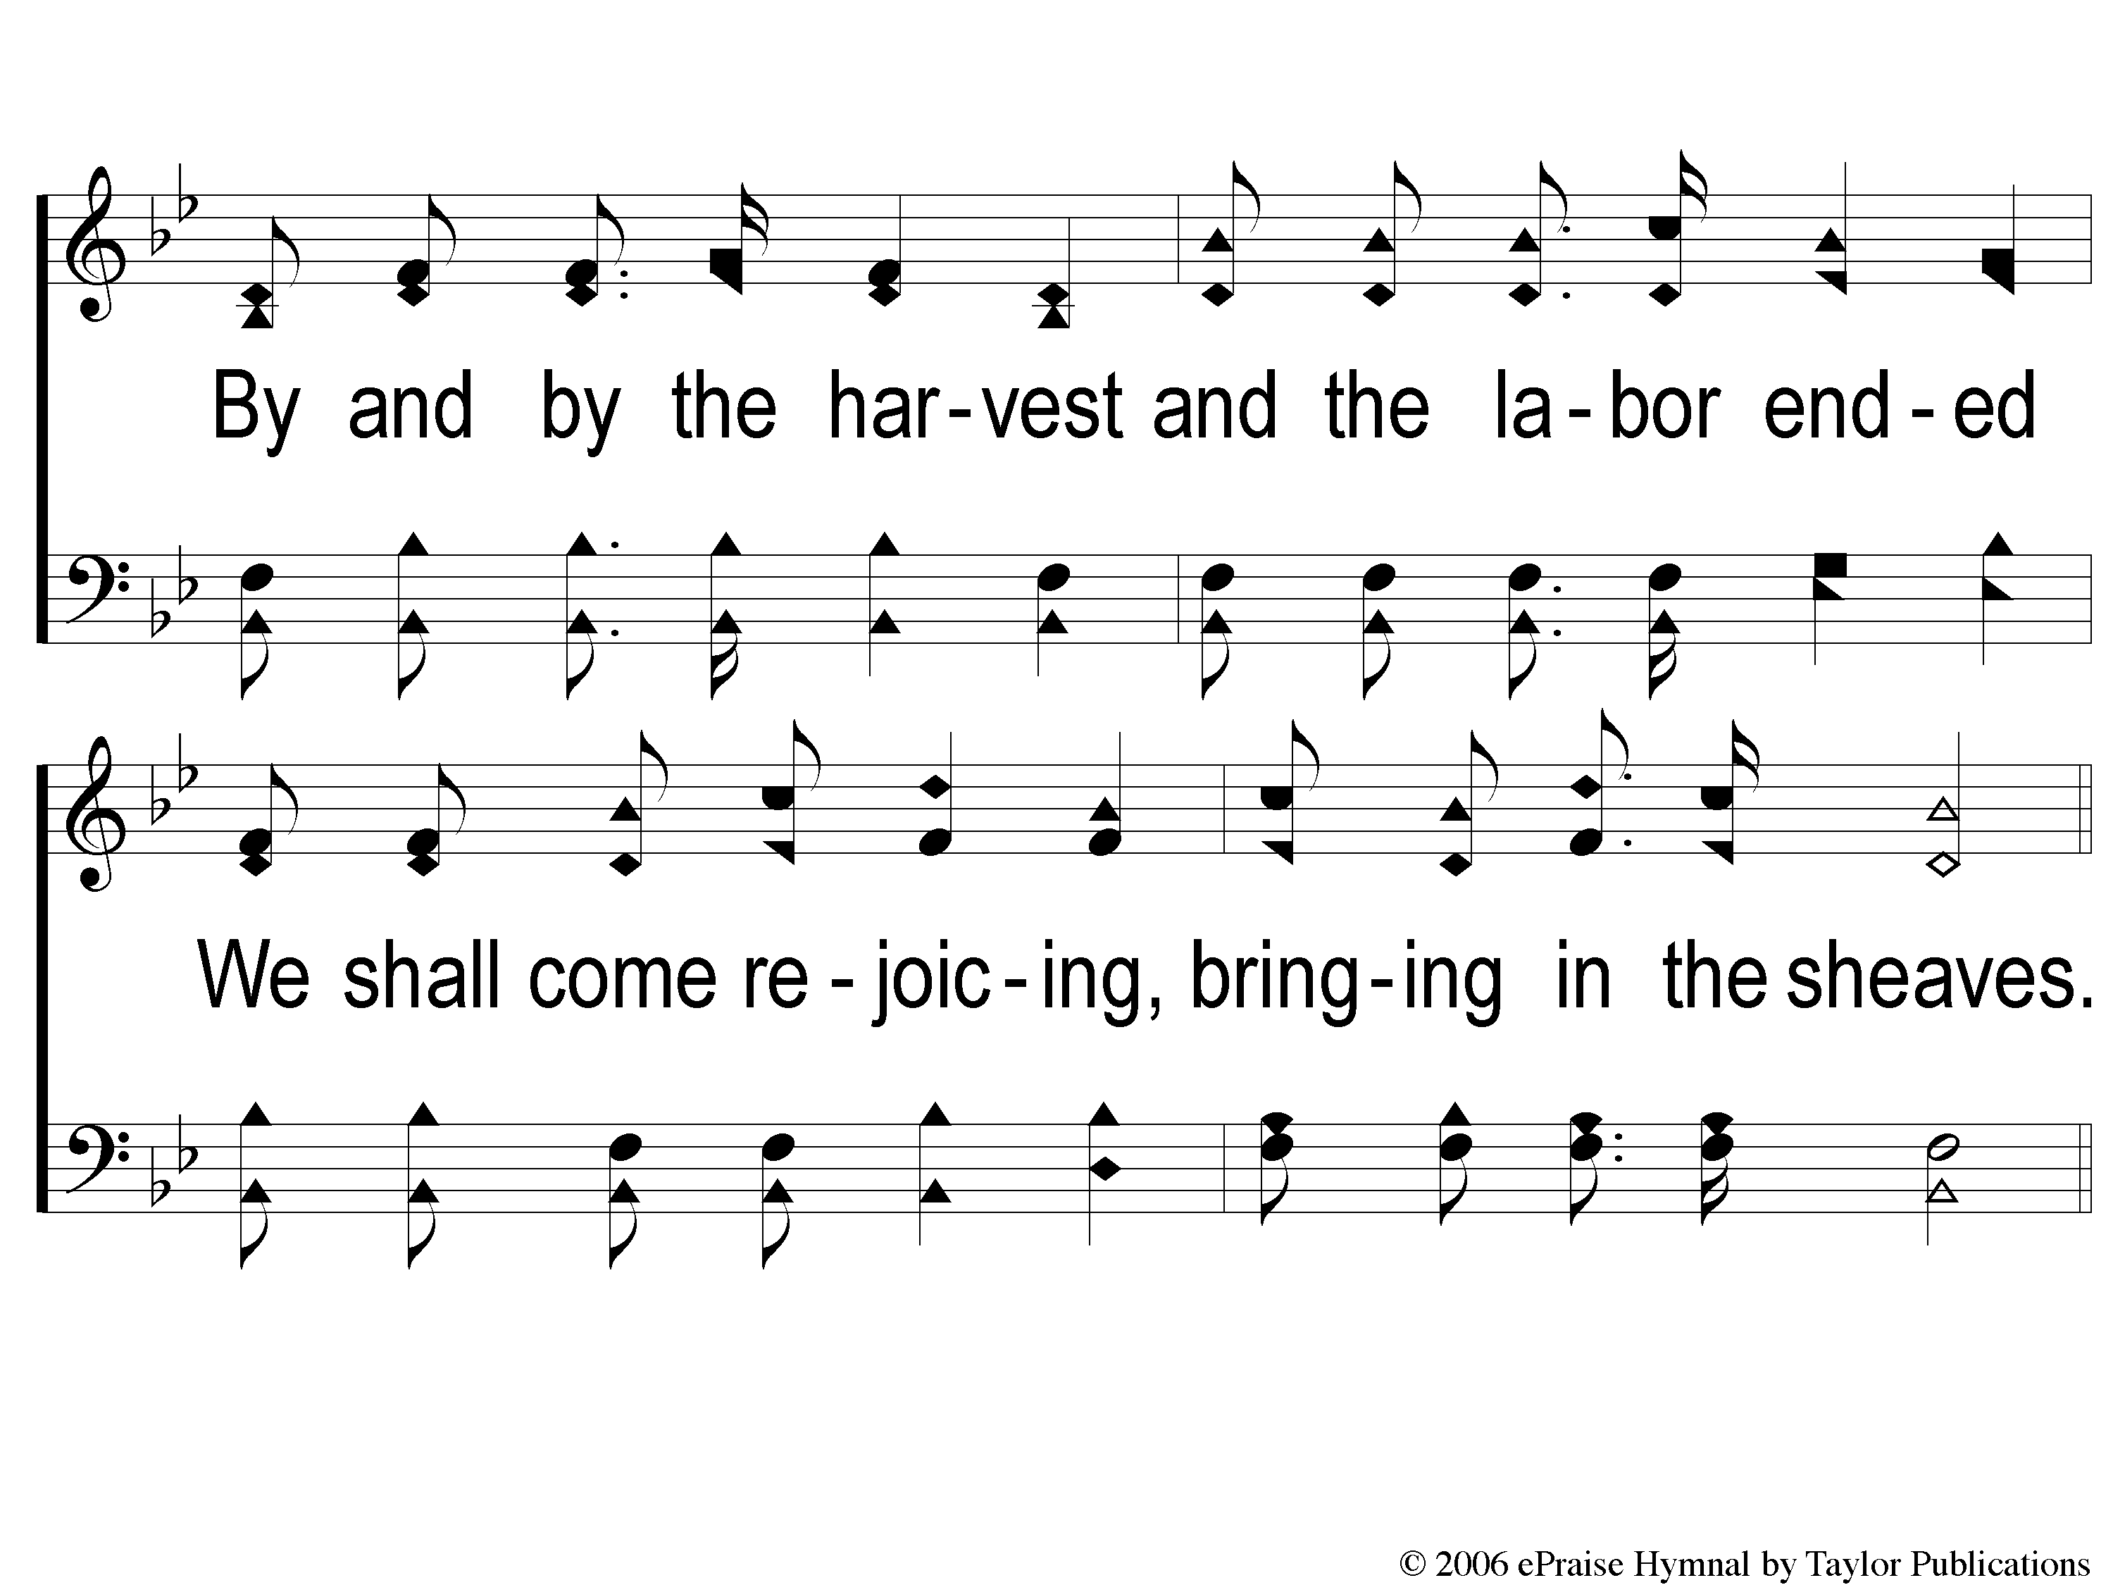
2-2 Bringing In The Sheaves
Bringing In The Sheaves
56

Slide 7
C-1 Bringing In The Sheaves
Bringing In The Sheaves
56

Slide 8
C-2 Bringing In The Sheaves
Bringing In The Sheaves
56

Slide 9
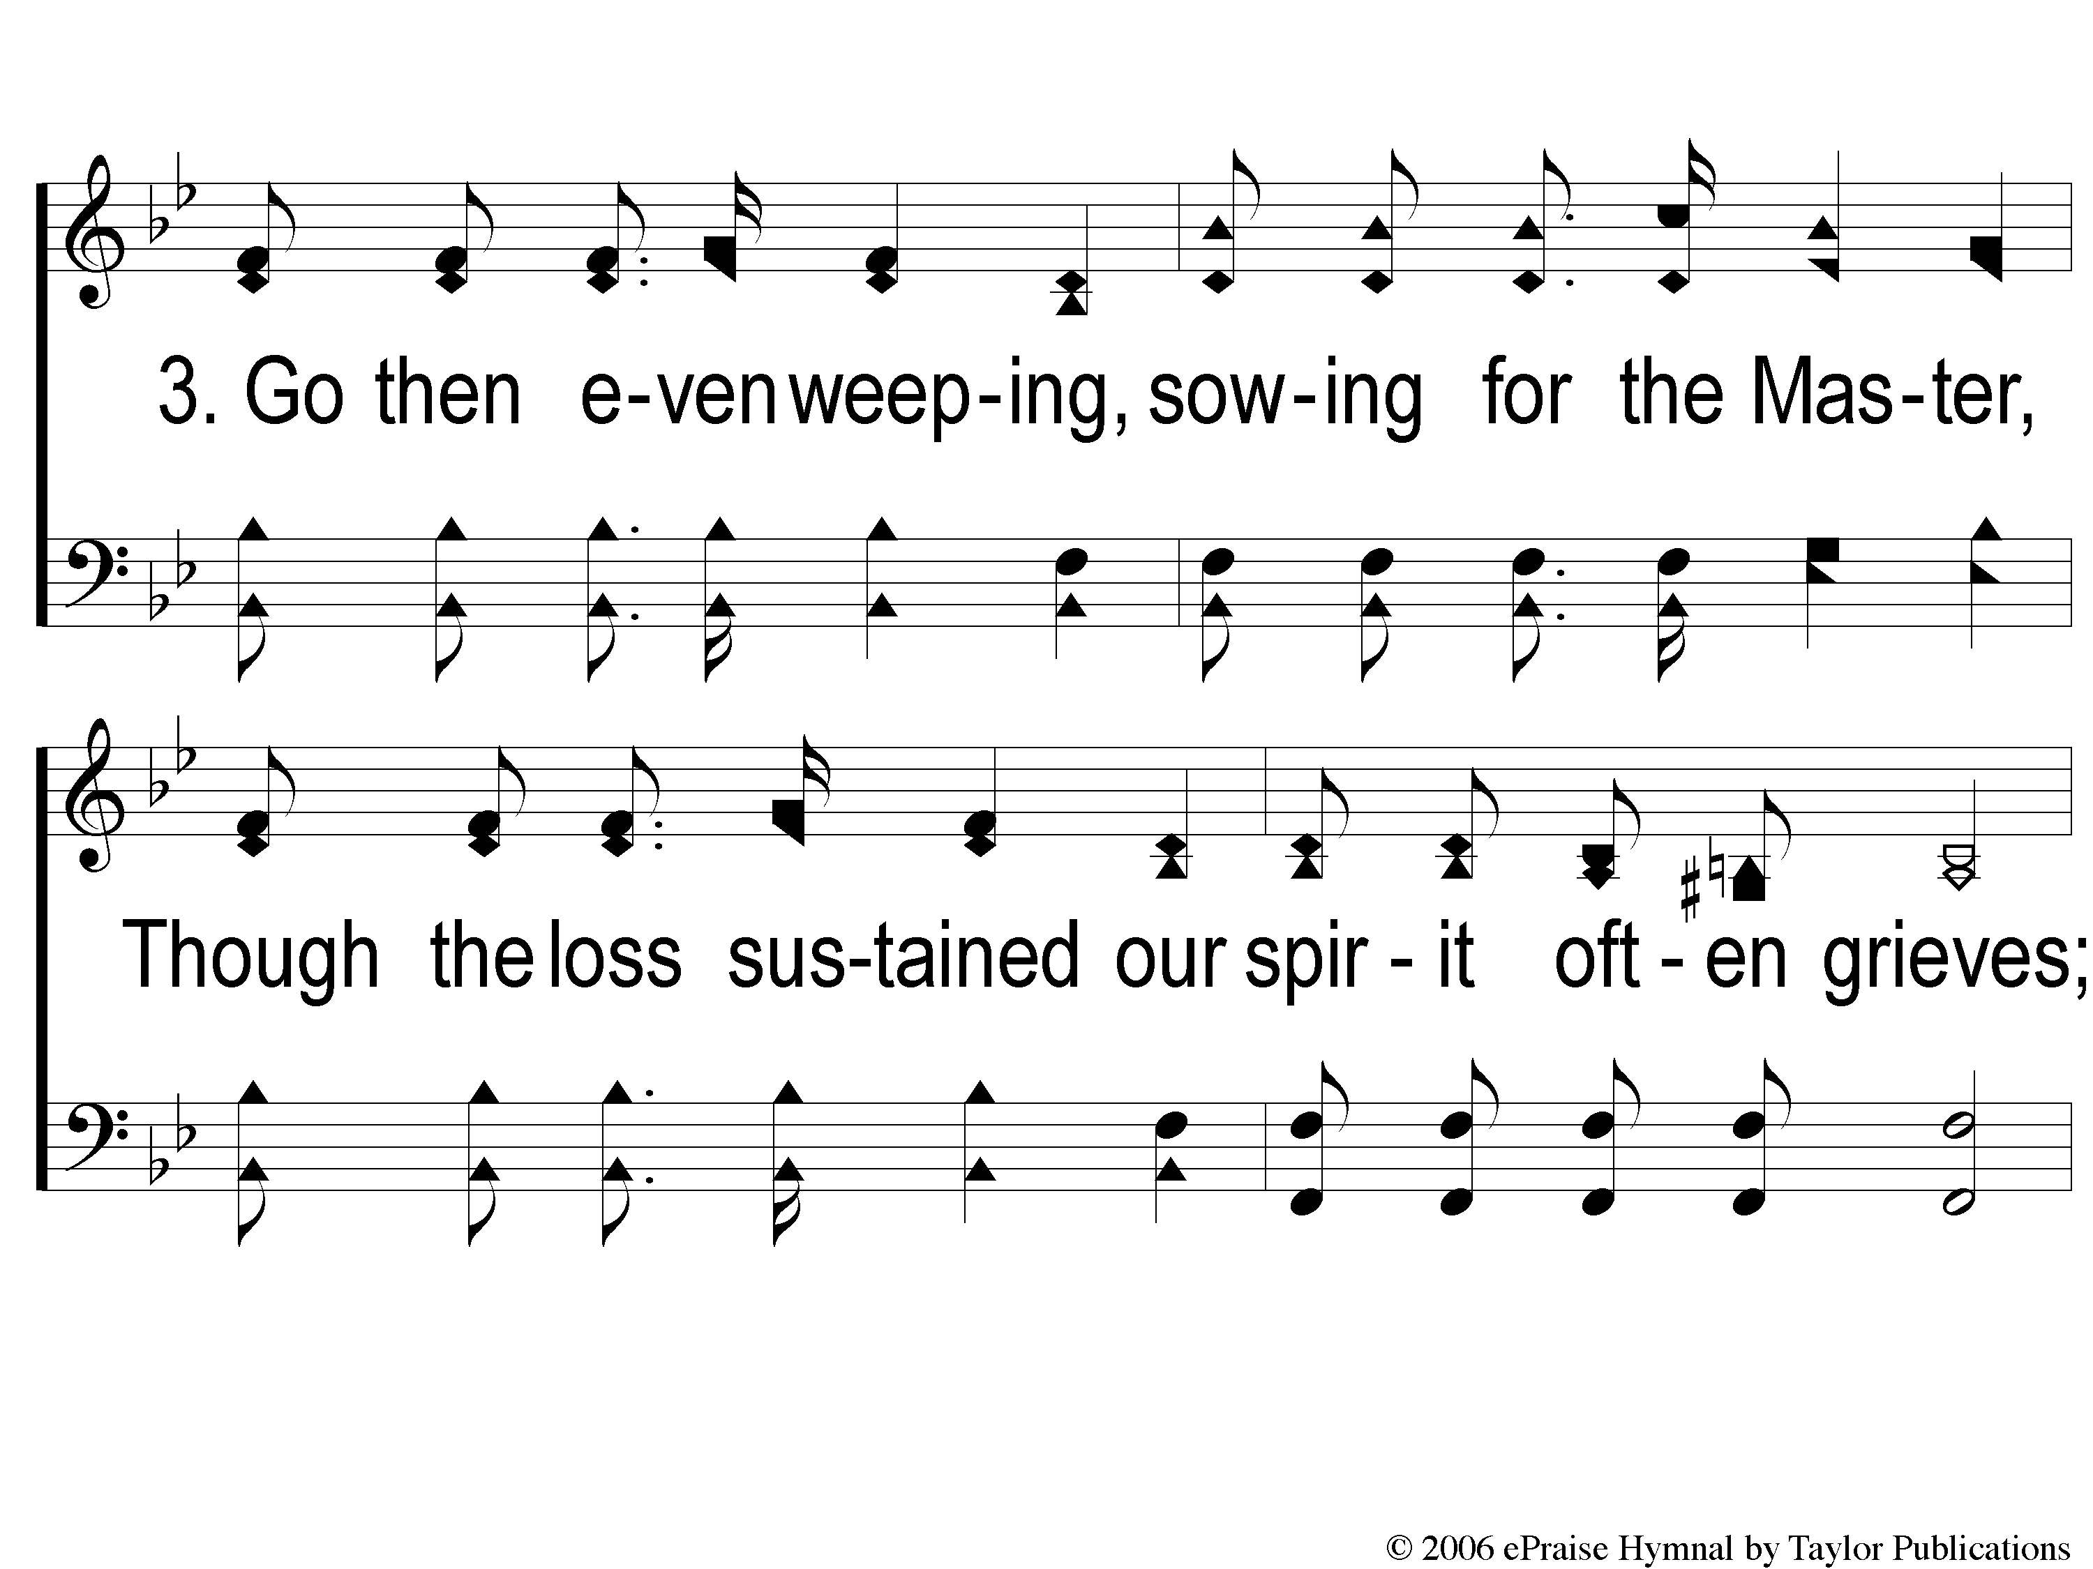
3-1 Bringing In The Sheaves
Bringing In The Sheaves
56

Slide 10
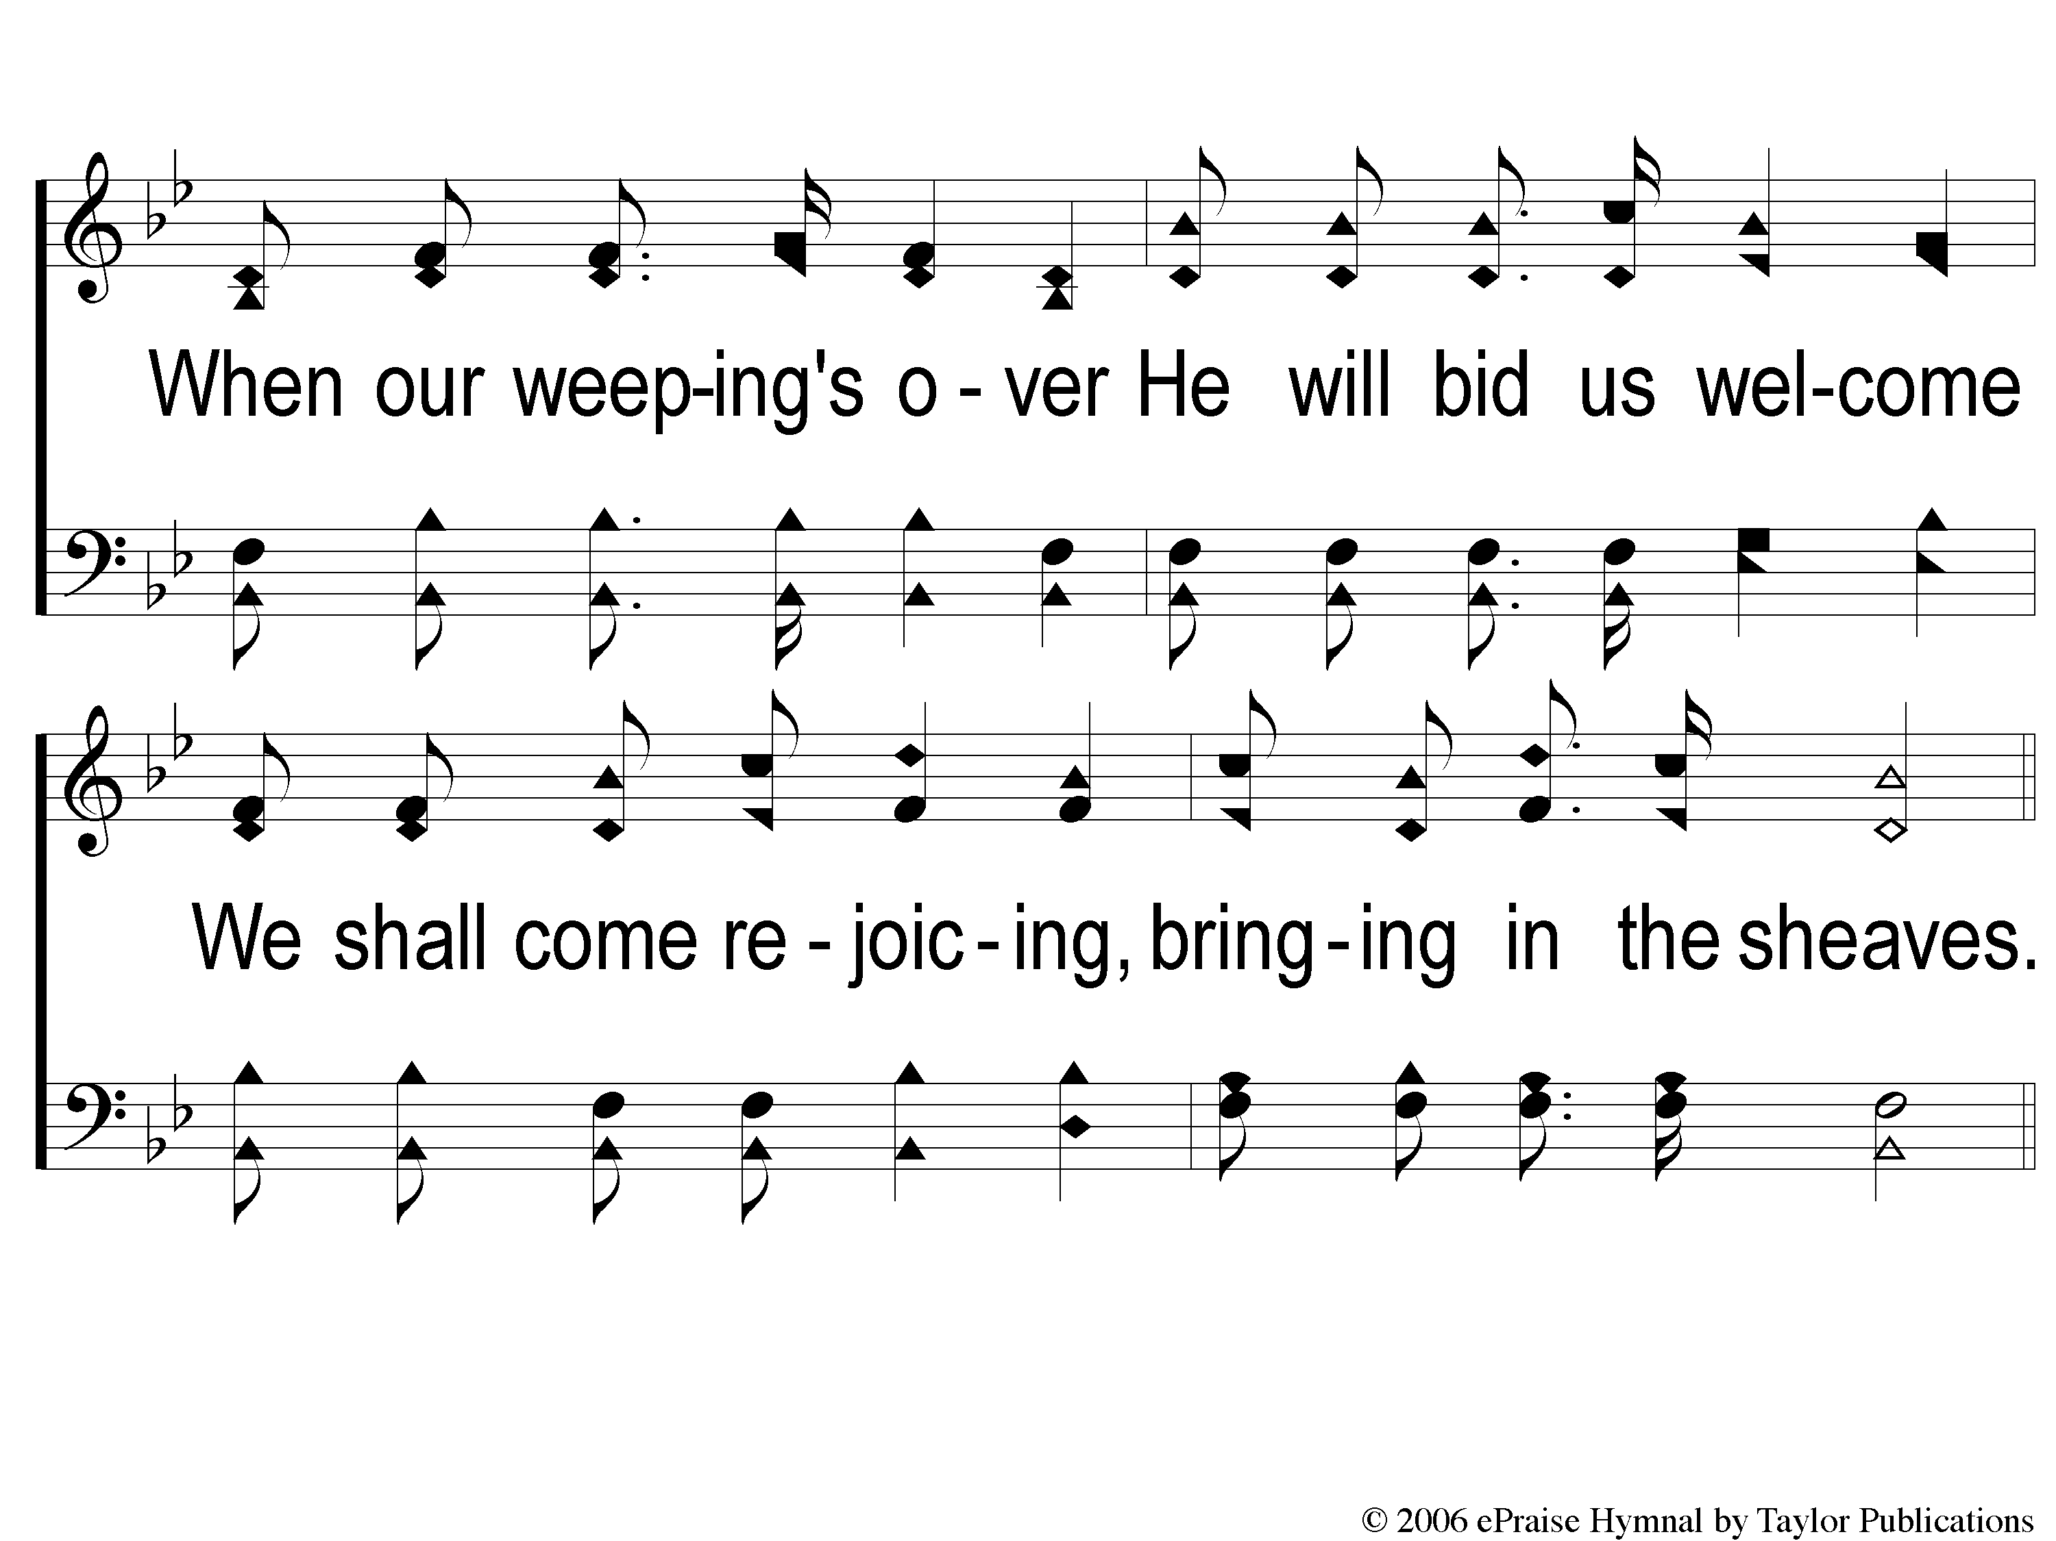
3-2 Bringing In The Sheaves
Bringing In The Sheaves
56

Slide 11
C-1 Bringing In The Sheaves
Bringing In The Sheaves
56

Slide 12
C-2 Bringing In The Sheaves
Bringing In The Sheaves
56

